Slide 1

Customer Loyalty Reward System: A PL/SQL Capstone Project
Student Name: TETA HUGUETTE
Student ID: 28982
Course: Database Development with PL/SQL (INSY 8311)
Institution: Adventist University of Central Africa (AUCA)
Academic Year: 2025

Slide 2


Addressing Inefficient Loyalty Management
The Problem
Target Audience & Context
Many organizations struggle with:
Target Users: Businesses seeking automated loyalty management, from small retailers to large enterprises.
Manual, error-prone record keeping for loyalty programs.
Context: Retail, e-commerce, and service industries where customer retention is critical.
Inaccurate loyalty point calculations.
Impact: Enhancing customer satisfaction and fostering repeat business through fair and transparent rewards.
Lack of insights from customer behavior data.
This leads to reduced customer retention and missed business opportunities.

Slide 3

Automated Loyalty: Our Solution
Automated Point Calculation
Improved Customer Retention
Data Consistency & Integrity
Automatically compute loyalty points based on defined business rules, eliminating manual effort.
Enhance customer satisfaction and loyalty through a transparent and efficient reward system.
Utilize PL/SQL constraints and triggers to ensure high data quality and reliability.
Comprehensive Audit Trails
BI-Ready Reporting
Maintain detailed logs of all transactions and system actions for full transparency and accountability.
Provide a robust foundation for analytical reporting, supporting informed decision-making.

Slide 4

Database Foundation: ER Diagram & Entities
CUSTOMERS
POINT_RULES
PURCHASES
REWARDS
Core Entities:
1
CUSTOMERS
Stores customer details (ID, name, email).
2
PURCHASES
Records transactions (purchase ID, amount, date).
3
REWARDS
Tracks points earned, redeemed, and reward dates.
4
POINT_RULES
Defines loyalty point conversion rules.
5
TRANSACTIONS_LOG
Logs all automated database actions.

Slide 5
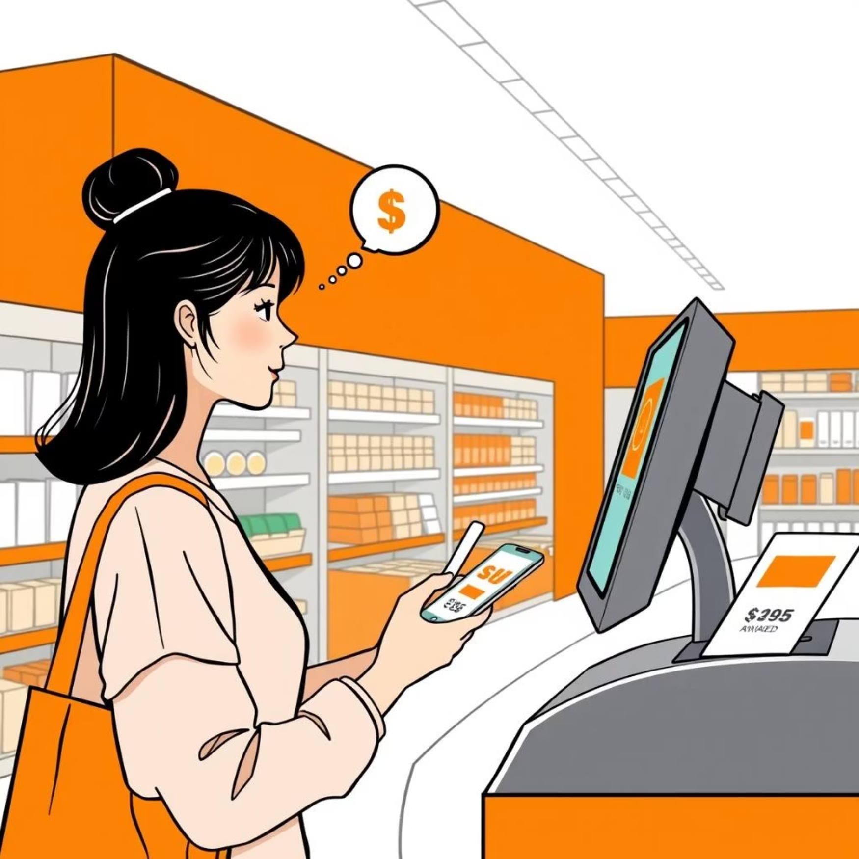

System Architecture & Business Process Flow
Key Features Overview
Automated loyalty point computation via PL/SQL.
Real-time updates triggered by purchases.
Secure logic for reward redemption.
Modular PL/SQL packages for maintainability.
Comprehensive transaction auditing and logging.
Schema designed for seamless BI integration.

Slide 6
PL/SQL Implementation: The Engine of Loyalty
Our system leverages robust PL/SQL components to automate and manage the entire loyalty reward process.
Procedures
Functions
Triggers
Packages
Record new purchases efficiently.
Calculate total accumulated points.
Auto-calculate points post-purchase.
Logically group related loyalty functions.
Process loyalty point redemptions.
Validate customer data and eligibility.
Enforce critical business rules.
Enhance code modularity and reusability.

Slide 7

Advanced Features: Auditing & Security
Restriction Rule: Business Hours
Employees cannot insert, update, or delete records during weekdays (Monday-Friday) or on public holidays (upcoming month only). This ensures data integrity and prevents unauthorized access during critical periods.
Comprehensive Holiday Management
An integrated holiday management system ensures that the restriction rule is dynamically applied based on predefined holiday schedules.
Robust Audit Log Table
A dedicated TRANSACTIONS_LOG table captures every system action, including denied attempts, with user information and timestamps.
Trigger-Based Security Enforcement
Compound triggers are implemented to enforce these business rules automatically, validating all DML operations before execution.

Slide 8
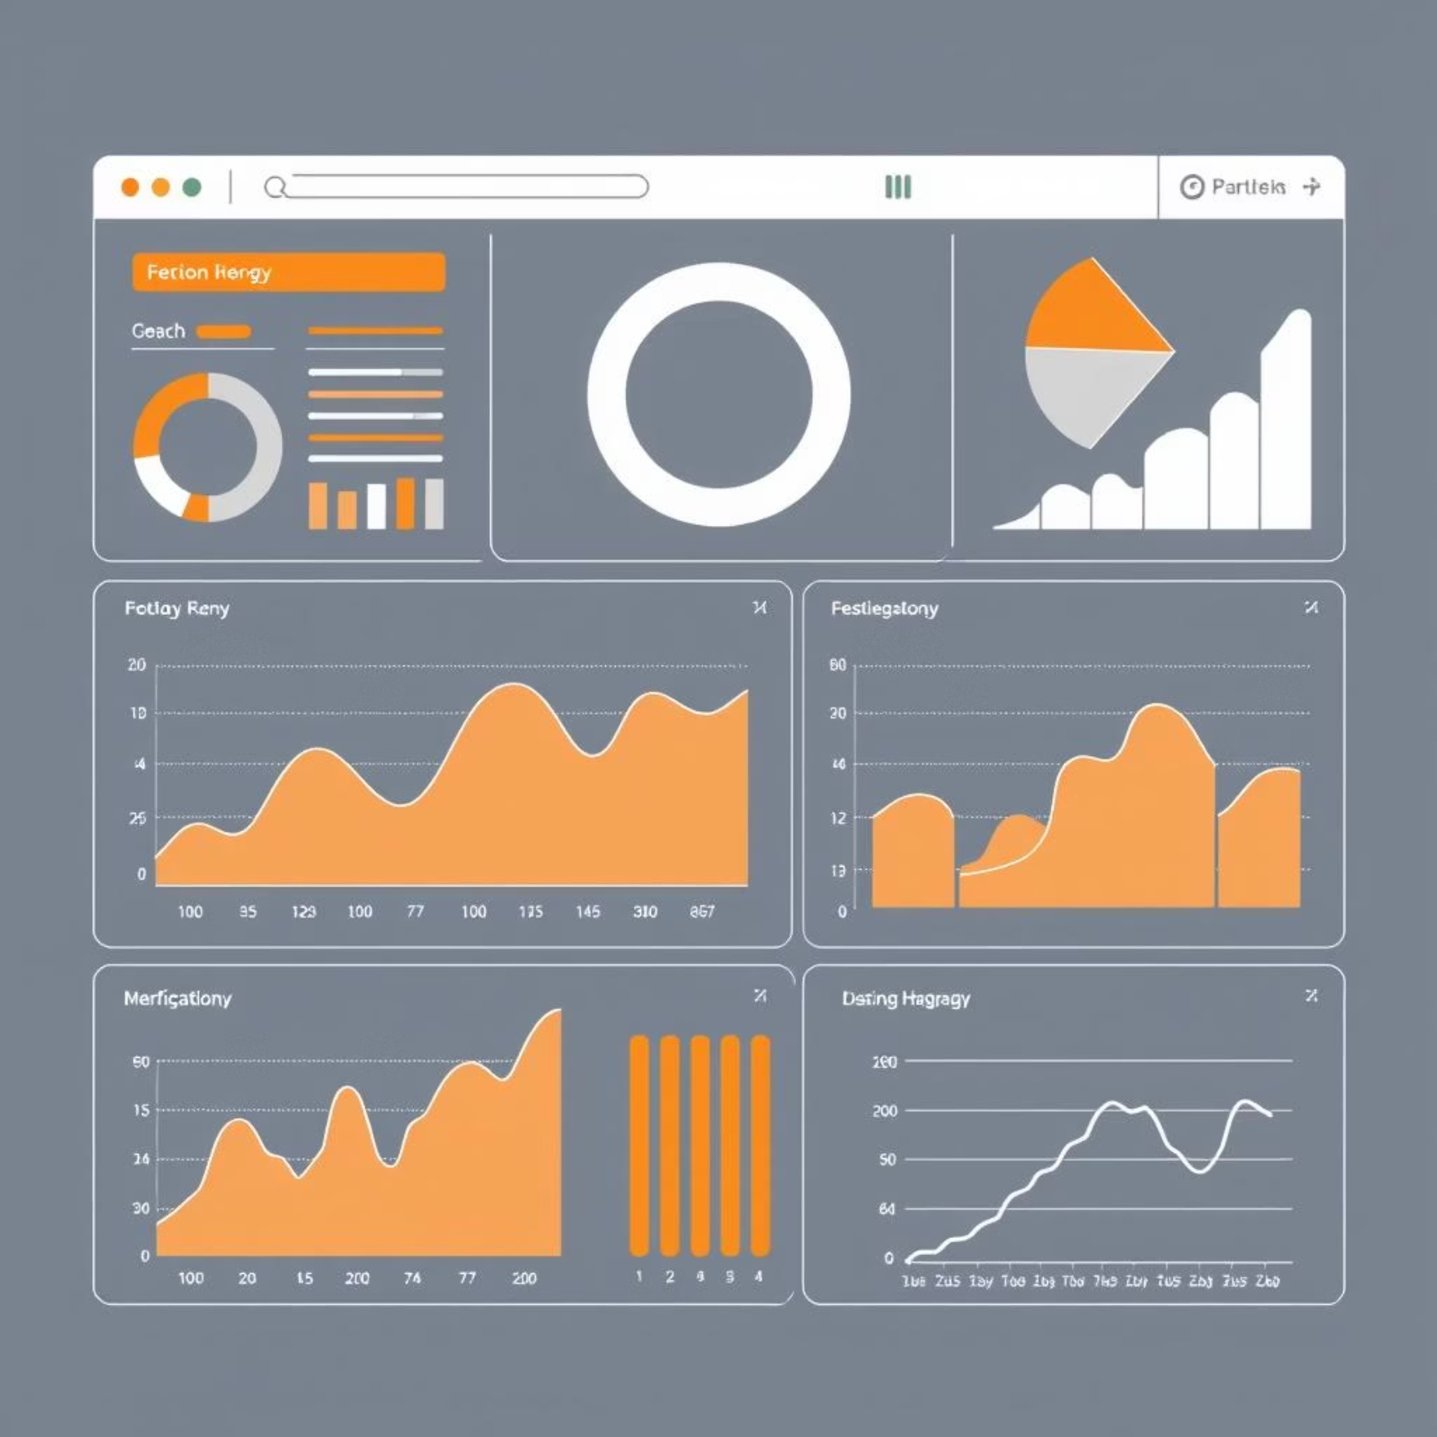
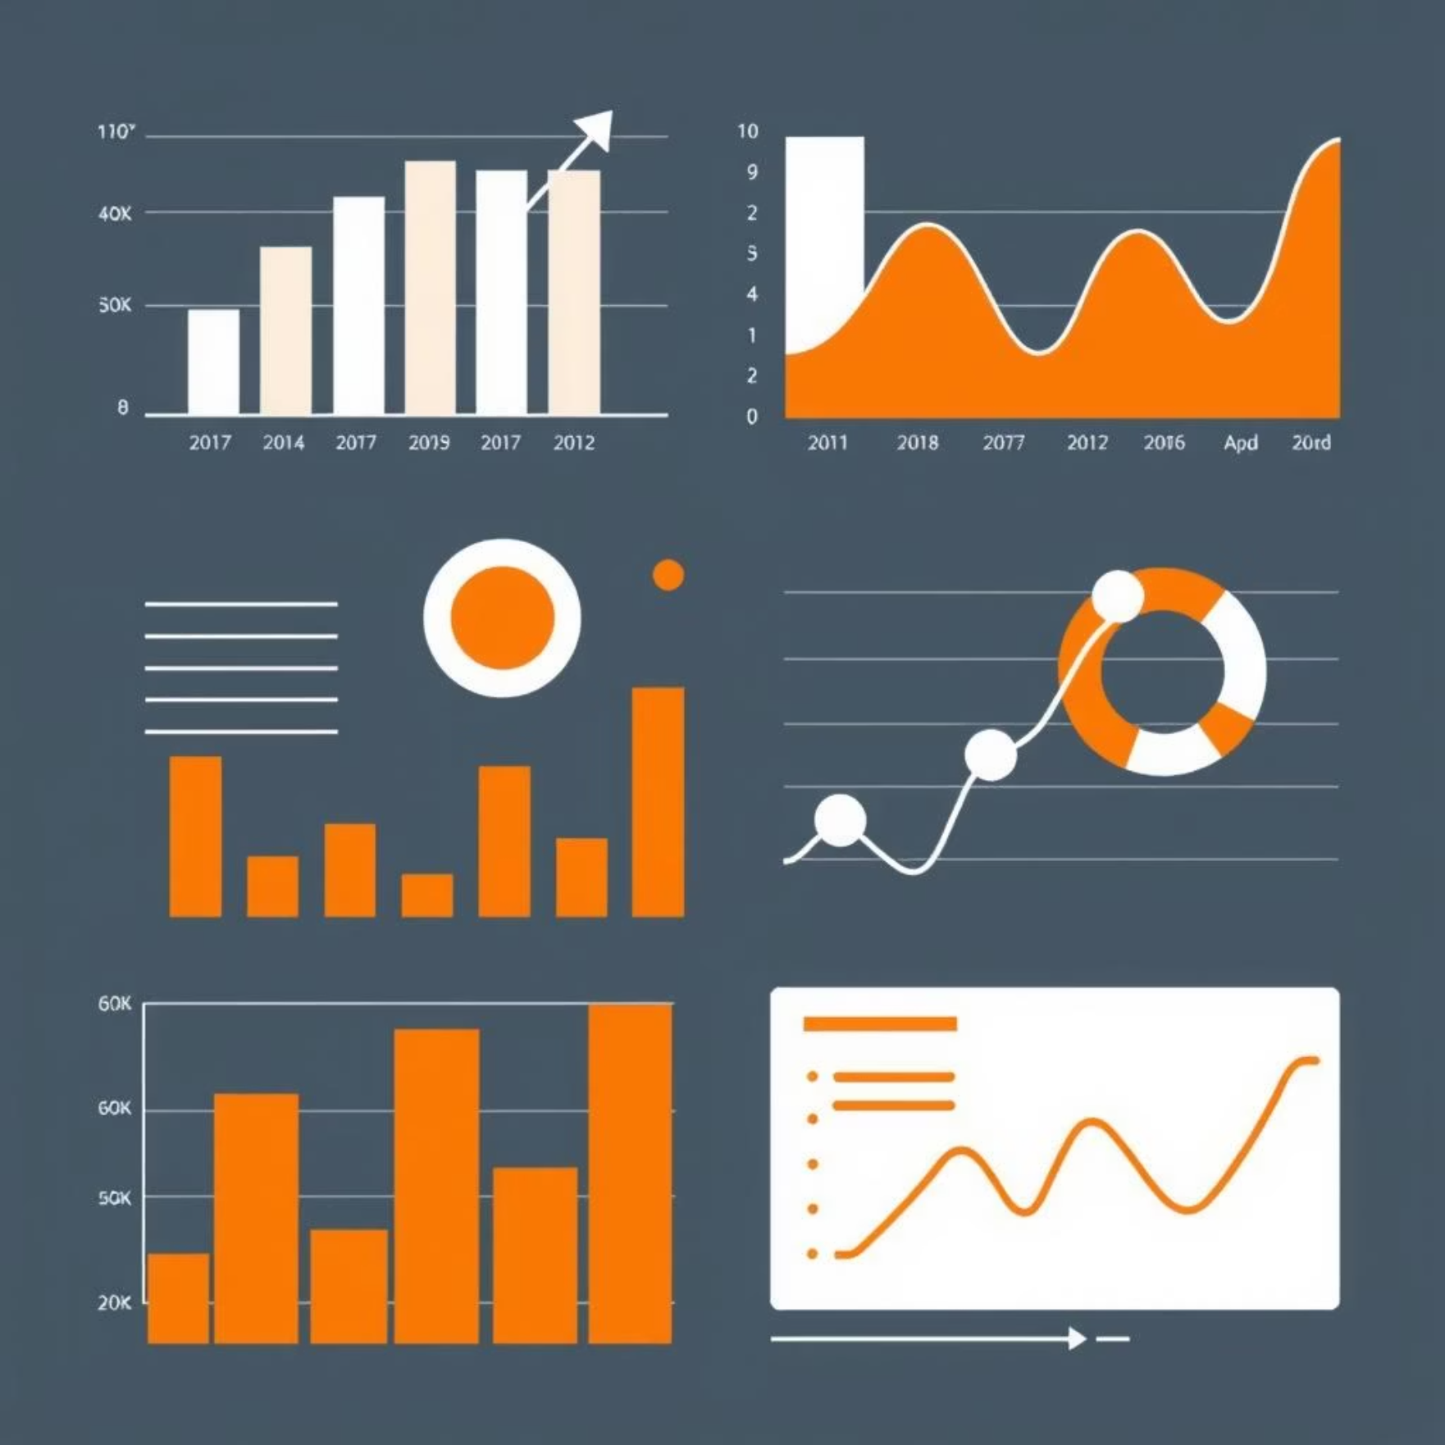
BI & Analytics: Transforming Data into Insight
The system is designed for seamless Business Intelligence integration, turning raw data into actionable insights.
Key Performance Indicators (KPIs)
Dashboard Mockups
Customer spending trends.
Executive Summary: High-level KPIs, trends, and growth metrics.
Identification of top loyal customers.
Audit Dashboard: Overview of violations, denials, and system activities.
Reward redemption frequency analysis.
Performance Dashboard: Database resource usage and query performance.
Monthly and yearly performance comparisons.
This framework enables businesses to make data-driven decisions that enhance customer satisfaction and optimize loyalty programs.

Slide 9
Project Validation: Testing & Impact
99%
100%
800+
Test Case Success
Constraint Enforcement
Realistic Data
All procedures, functions, and triggers passed rigorous testing scenarios, including edge cases.
Database constraints (PKs, FKs, NOT NULL) were validated to ensure data integrity.
Generated realistic test data across main tables to simulate real-world scenarios.
Innovation & Impact
This project replaces manual loyalty tracking with an automated, rule-based, and auditable database solution. By leveraging PL/SQL, it provides instant point calculation and robust data management, significantly reducing human errors and providing clear, structured data for business analysis.

Slide 10
Conclusion & Future Directions
1
Mastery Demonstrated
Successfully integrated Oracle Database and PL/SQL for a reliable, automated loyalty system.
2
Practical Skills
Showcases strong abilities in database modeling, PL/SQL programming, and business-oriented problem-solving.
3
Real-World Readiness
Transforms raw data into useful information, forming a foundation for enterprise-level systems.
Future Expansion
4
The modular design allows for easy integration with advanced analytics tools and future feature enhancements.
Achievements: Developed a production-ready, automated loyalty reward system.
Lessons Learned: Importance of rigorous testing, modular design, and robust error handling.
Questions & Discussion: Open for inquiries and feedback.
THANK YOUU !!!!!! GOD BLESS YOU

